Slide 1
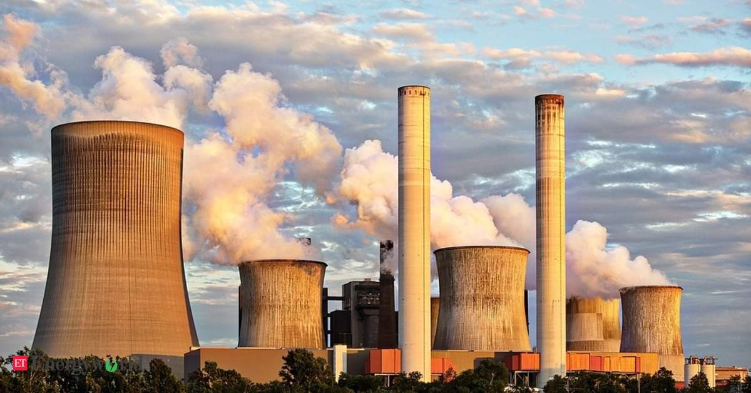
Case Study
Apturja Power Limited
Presented by
Antarlin Chanda – C22003
Shramana Bhattacharya – C22022

Slide 2
Problem Definition
Voluntary attrition among fresh college graduates has been 45.5% in 2018 and 54.5% in 2019.
In spite of high performance of around 70%, new joinees resigned sighting reasons of lack of excitement at work
APL tried to improve employee retention by introducing various HR strategies like incentives, lucrative package, residential quarters, etc., however, the situation did not improve.

Slide 3
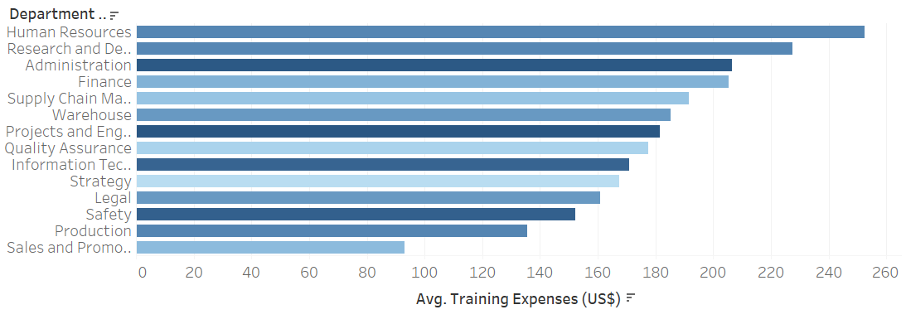
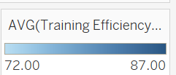
Analysis and Problem Identification…1
Location wise Attrition
Attrition w.r.t source of hire and Alma Mater
Highest attrition is seen in locations such as Kawai and Korba which are also the places located farthest from urban areas or the airport.
The main reason for leaving also is that the job location is unfavorable.
IITians recruited from campus have accounted for almost 31% of the resignations.
Average training expense is maximum for HR and R&D, their attrition is also less.
Department wise Avg training expenses

Slide 4
Analysis and Problem Identification…2
Department wise Attrition
Attrition w.r.t previous residence
1. Job location being unfavorable turned out to be a high influencer in causing attrition. Production department has the highest number of people who resigned due to unfavorable location and better opportunities.
2. Madhya Pradesh Chhattisgarh Rajasthan and Gujarat were the location of the plant and we notice and interesting trend that people who are from these states have much lower attrition as maybe distance from home is mattering to them and for the other people the problem is exacerbated by the fact of remote hard to reach location

Slide 5
Analysis and Problem Identification…3
Notice Period wise Attrition
Attrition and None Engagement Rating w.r.t distance between home and workplace
Lower Notice Period are showing significantly higher attrition.
On average the further the employee stays from workplace, the lower is their job engagement and higher is the attrition rate.

Slide 6
Solutions
Instead of recruiting total fresh graduates APL can make a push for about 50 percent fresh and about 50 percent candidates with about 1 or 2 years of experience.
Hiring proportions from Campus and from IITs and DTU should be lowered as they are the major causes of attrition
Some what reshuffling in hiring proportions from 20 percent from high attrition sources like campus recruitment to sources which are less prone to attrition like LinkedIn and agency may be helpful.
0 day notice period should be tweaked to about 1 month so as to maintain a balance between employee job seriousness and future growth prospects. Too low notice period is harmful as people leave too easily and many people from campus just joining for the sake of having a job and on they the get other opportunities they quickly move away.
People who are staying further away from plant have higher non engagement rating and also higher attrition. Though it is given APL provides residential quarters maybe the township facilities provided may be the amenities are not up to higher standards as expected by employees and thus they choose to stay away.
Profit Percent's of company has gone down from 20.13 percent in FY 2015 to 7.42 percent in FY 2018 and 7.81 percent in FY 2019. this is an important factor that to keep company profitable the bonuses and increments being offered now is lower than what was before so that maybe pushing up attrition as maybe employees are not happy with their increments and bonuses now. This can be looked into.
Production department has higher workloads and also shift related duties. The should be compensated according to that. Maybe give shift duty bonuses and other related amenities to make up for their enhanced job stress.

Slide 7
THANK YOU

